Slide 1
Gilligan’s Coconut TV
Jose Rodriguez
Justas Vikonis
Fredrick Birr
Shayne Bloom
Khaja Ameenuddin

Slide 2
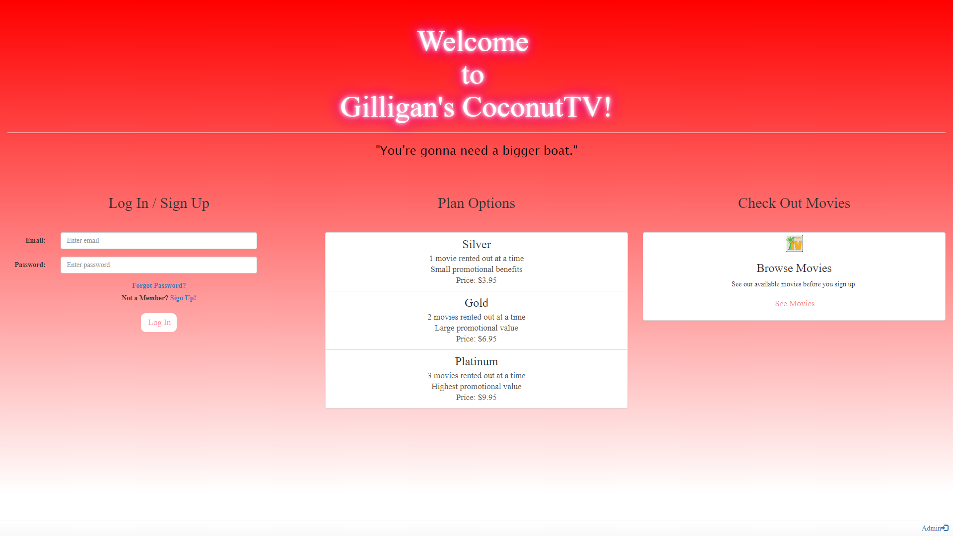

Slide 3
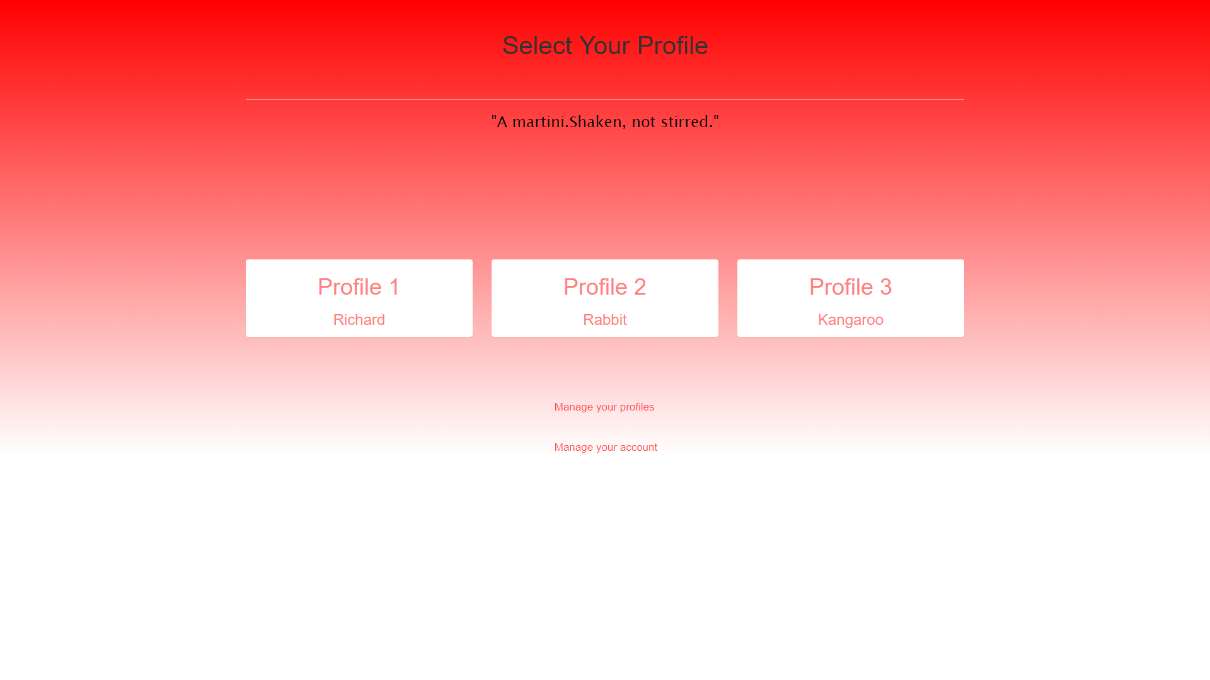

Slide 4
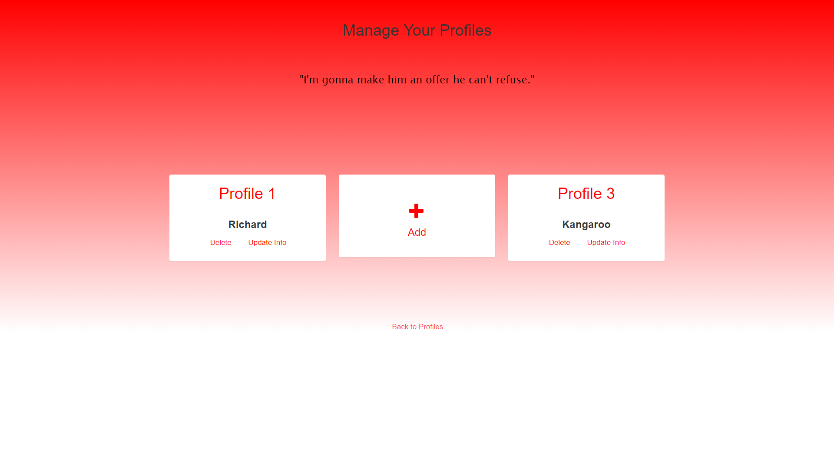

Slide 5
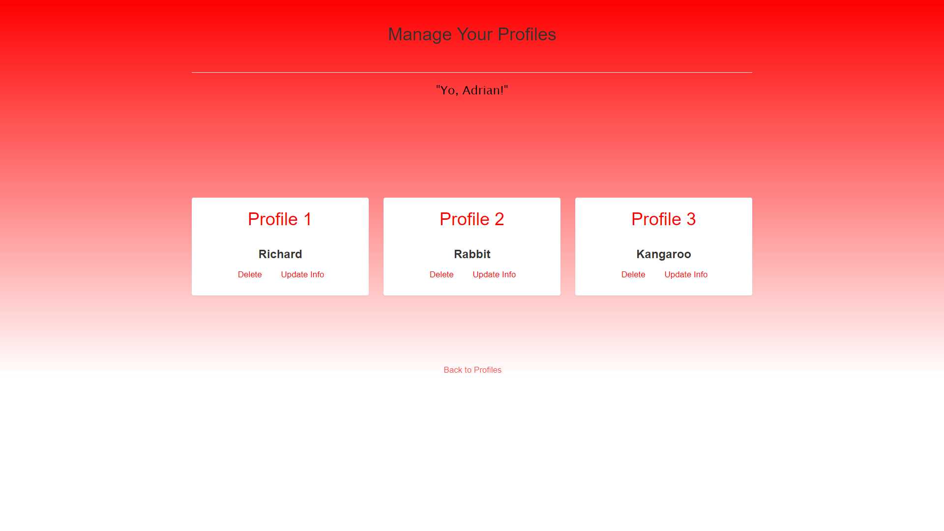
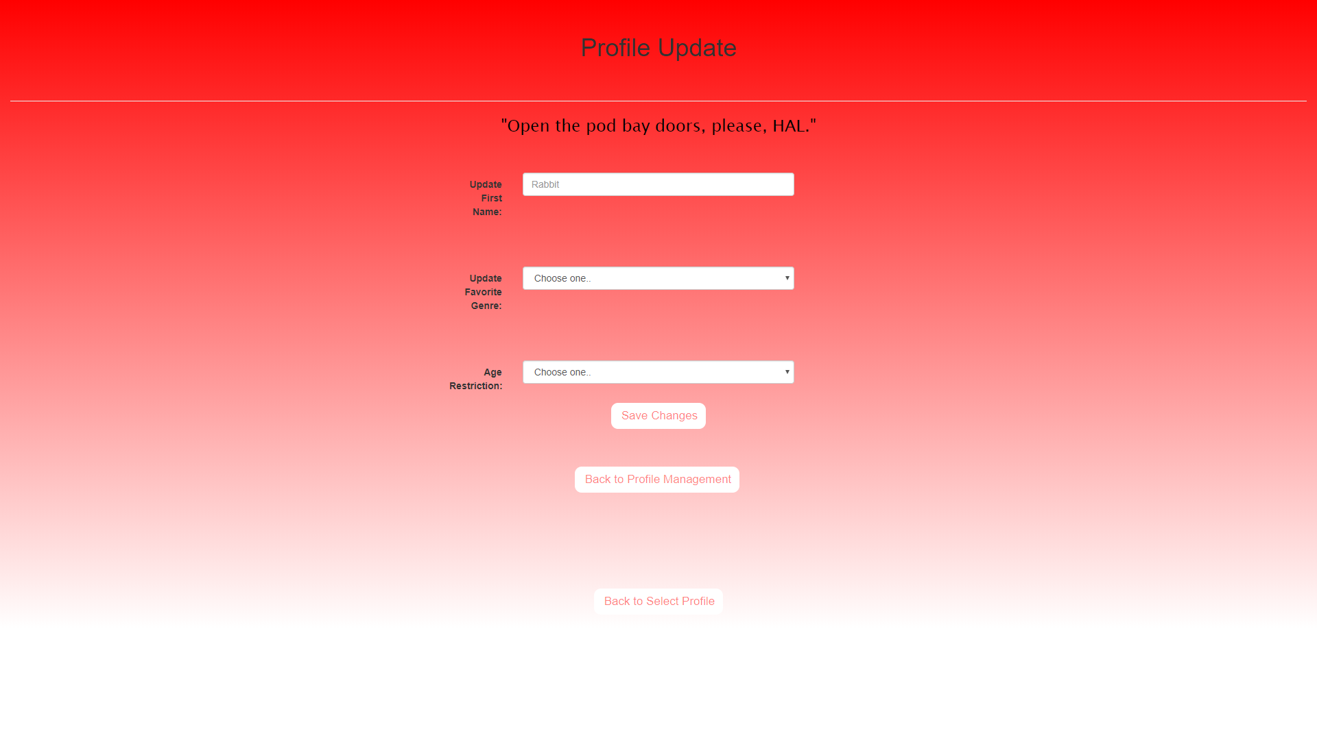

Slide 7
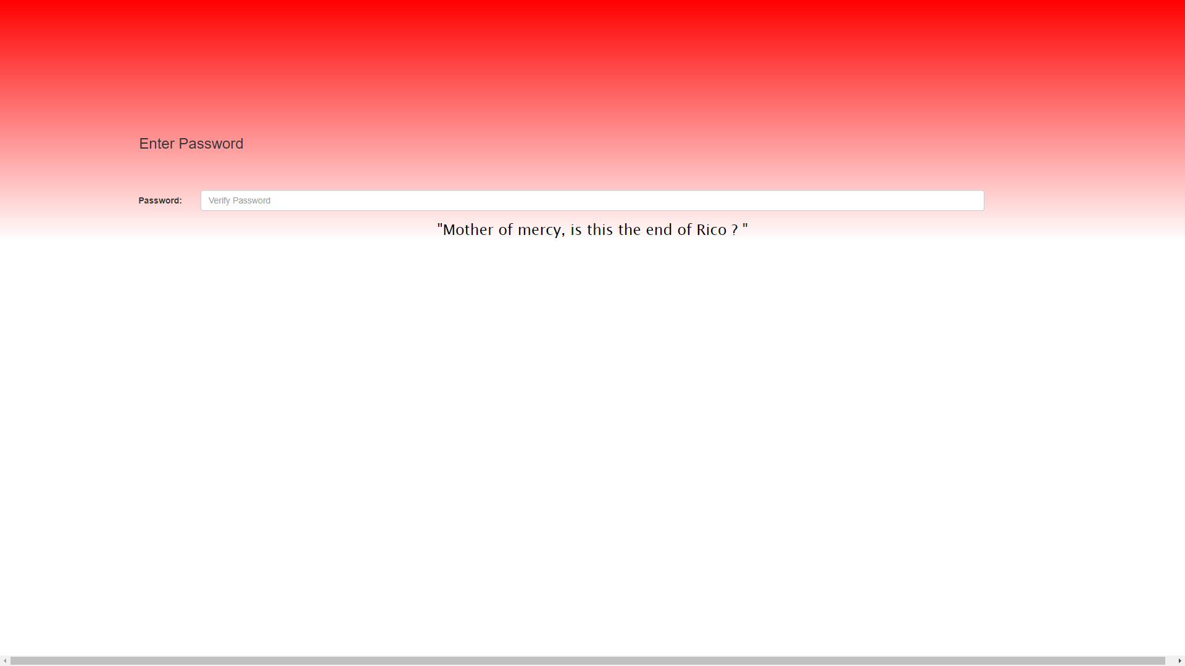

Slide 8
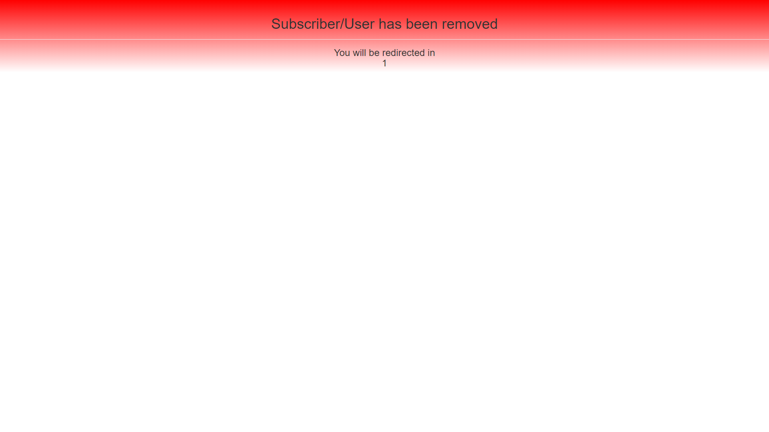

Slide 10
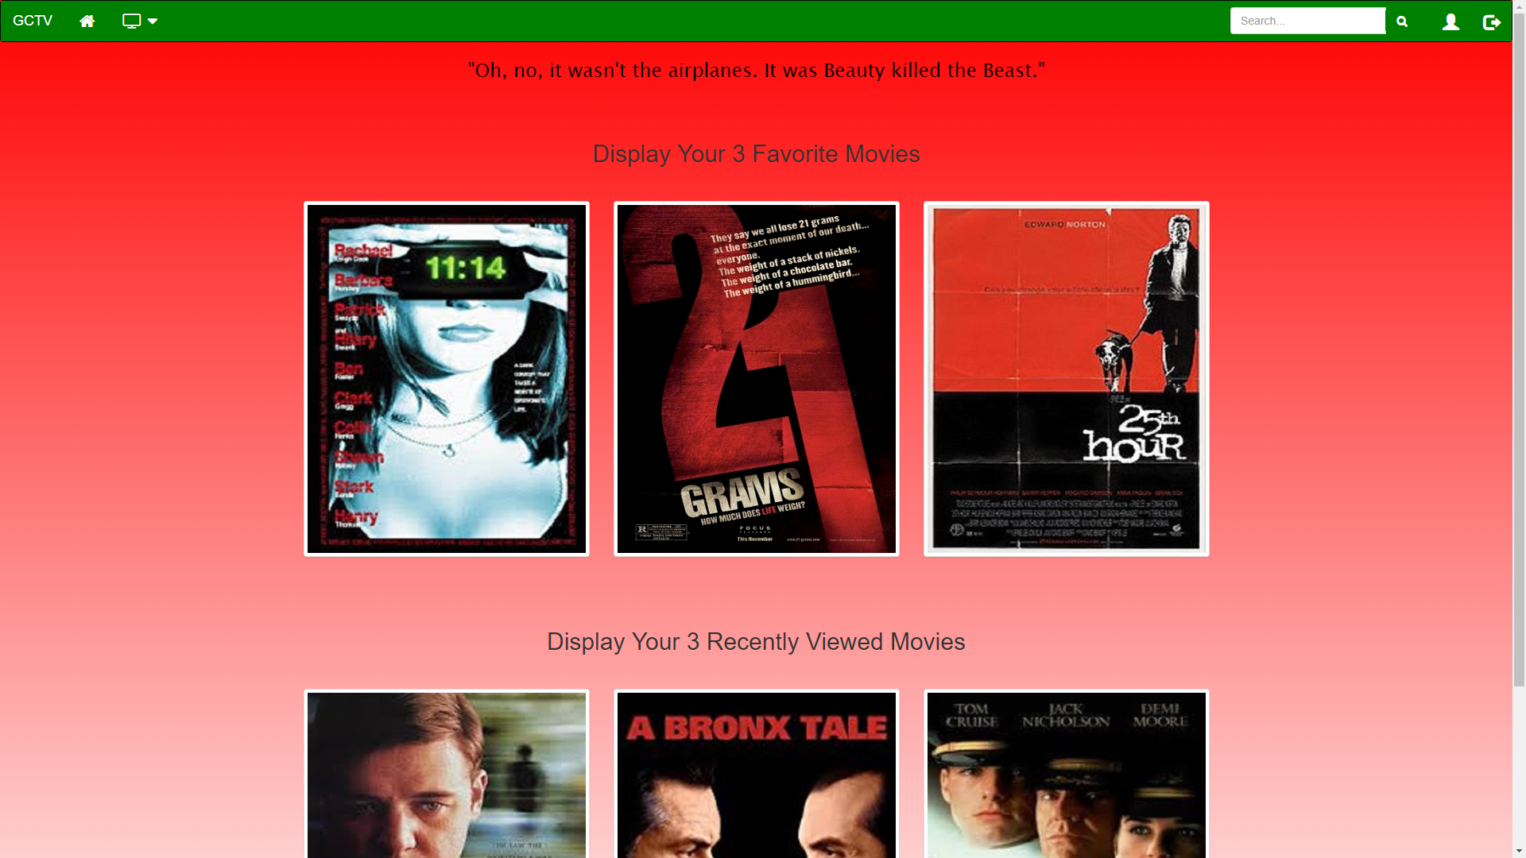

Slide 11
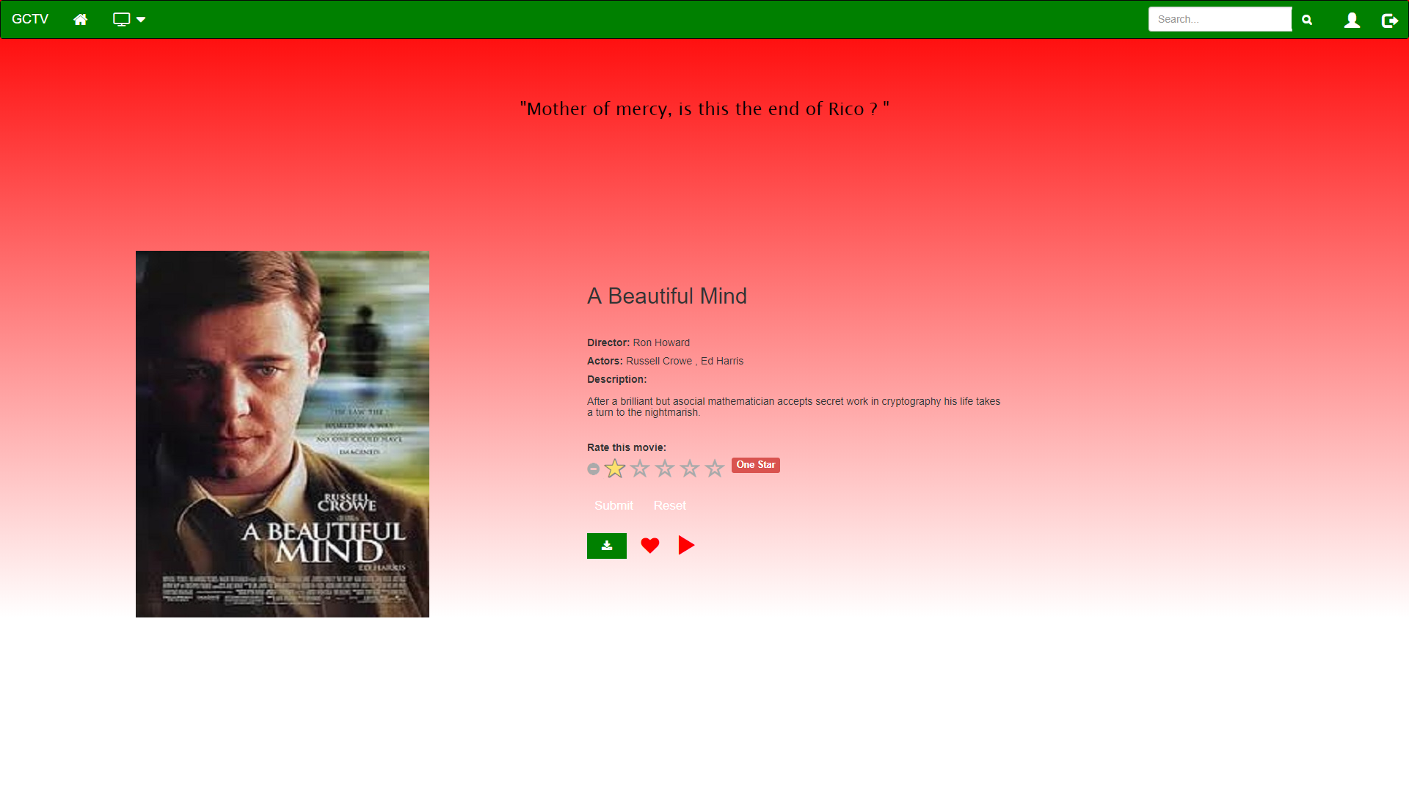

Slide 12
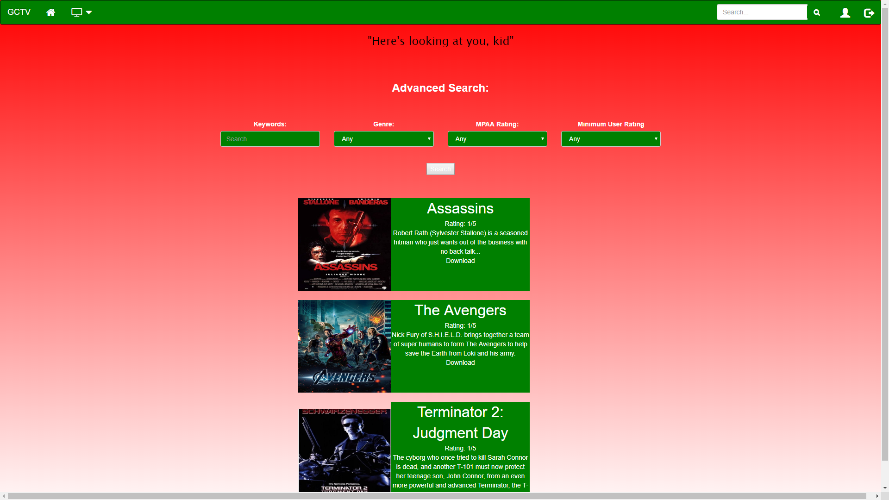

Slide 13
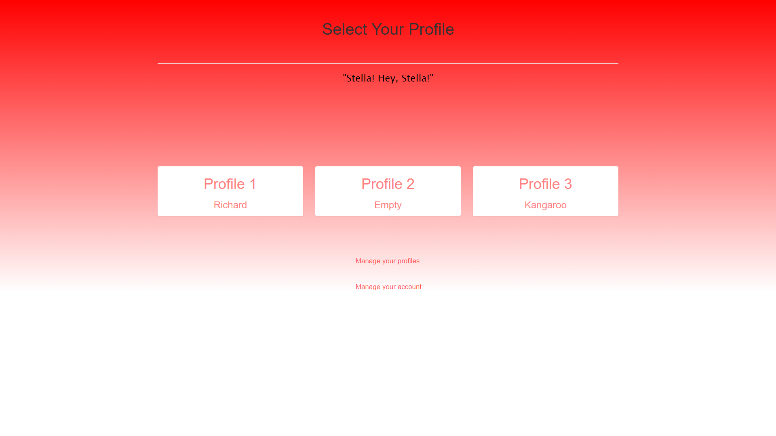

Slide 14
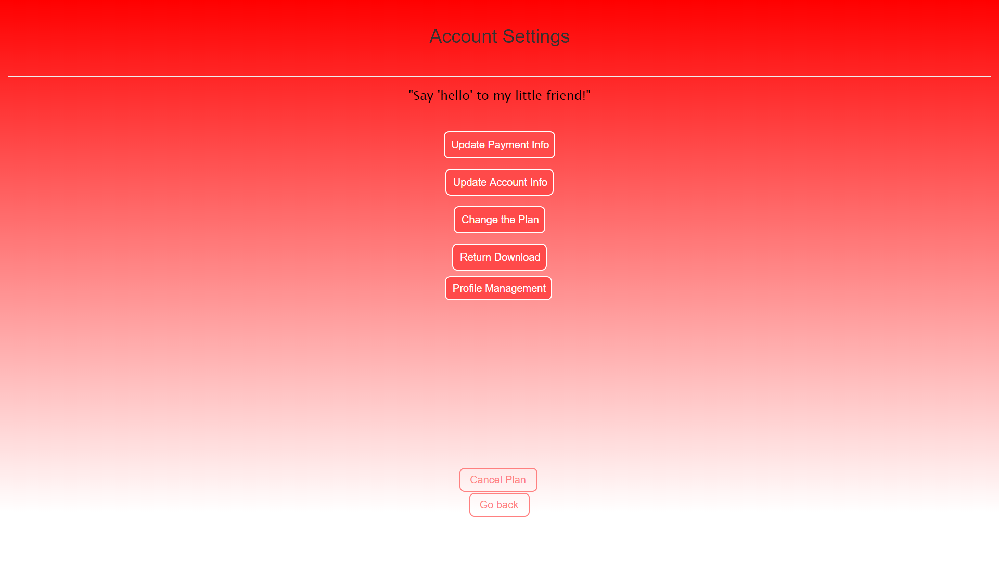

Slide 15
Administrative Tools

Slide 16
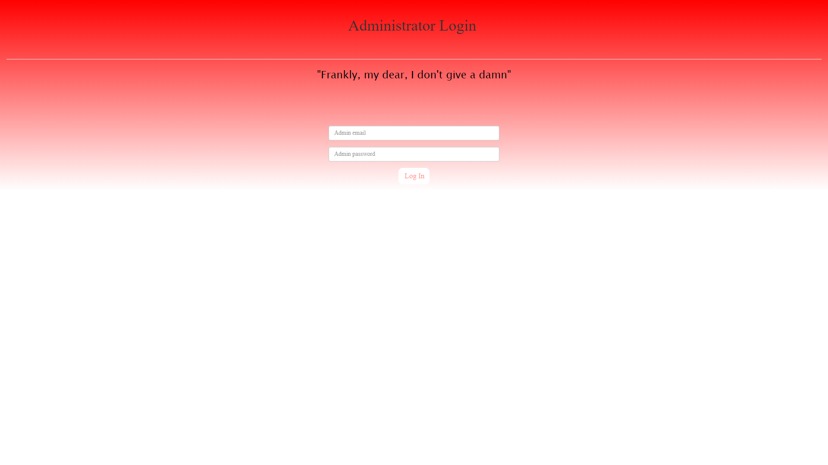

Slide 17
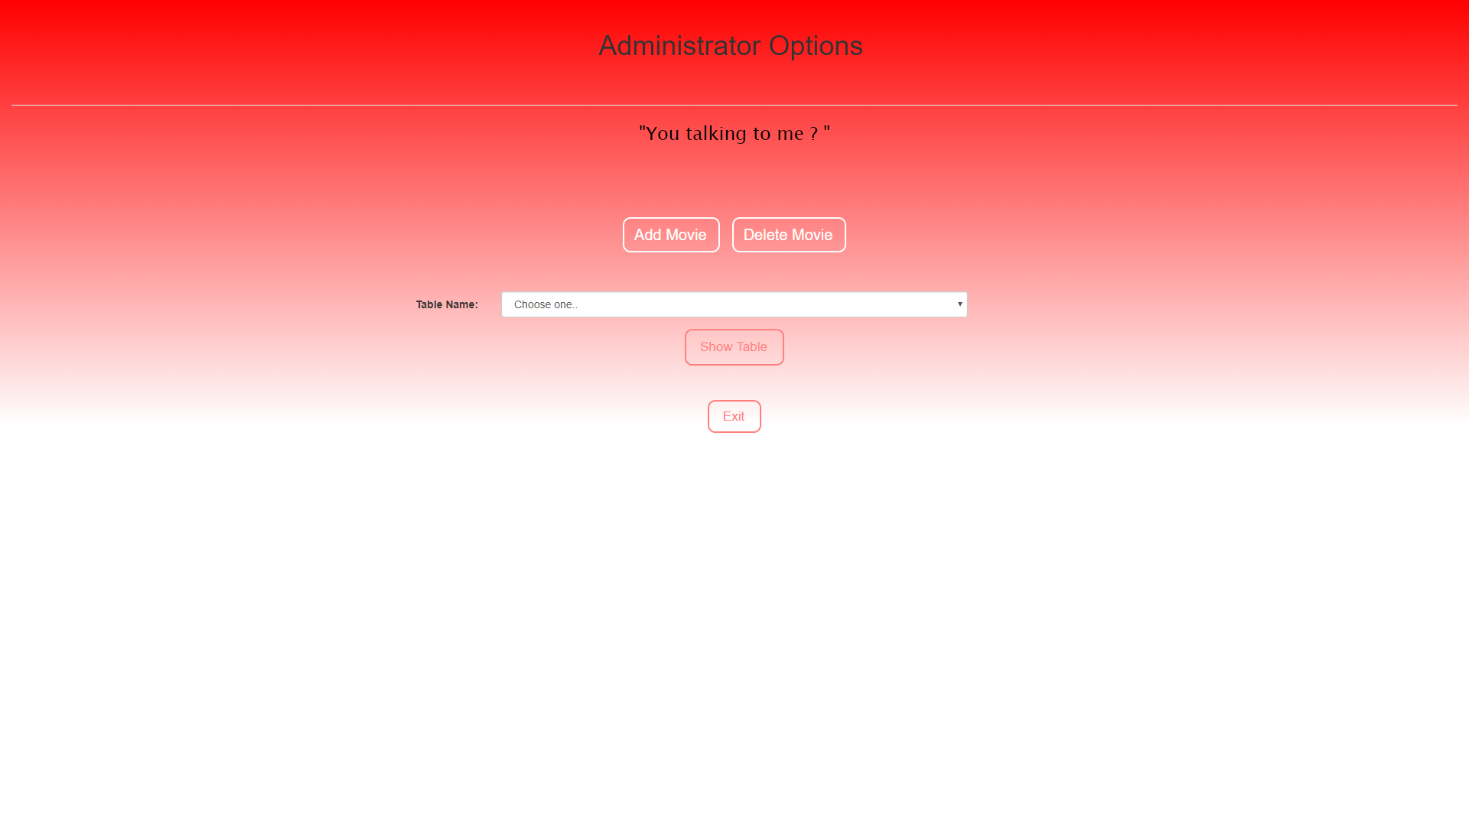

Slide 18
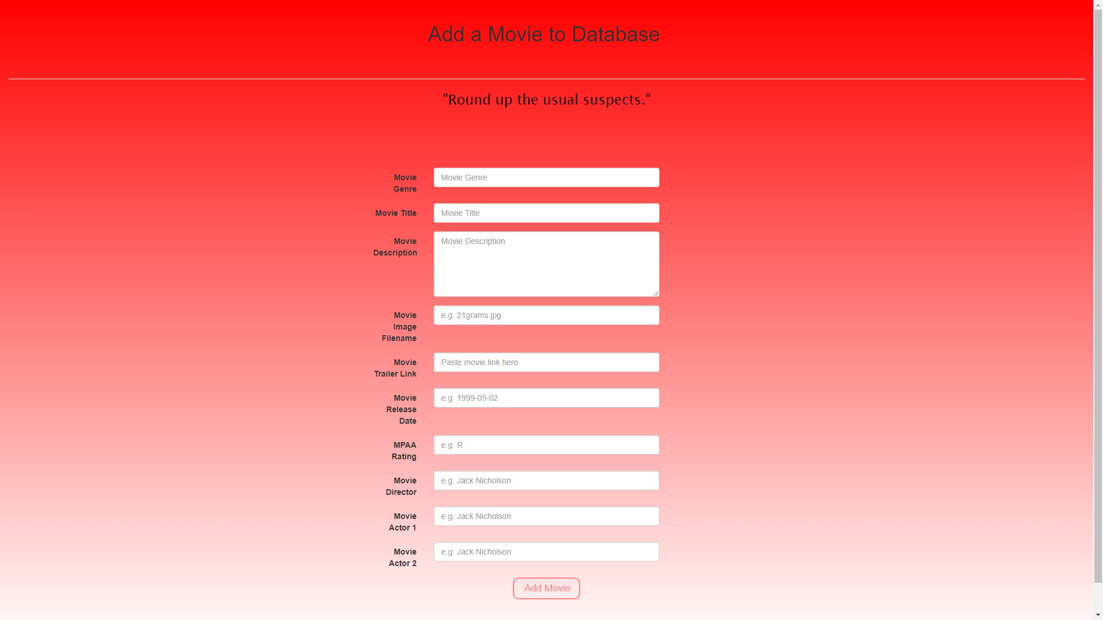

Slide 19
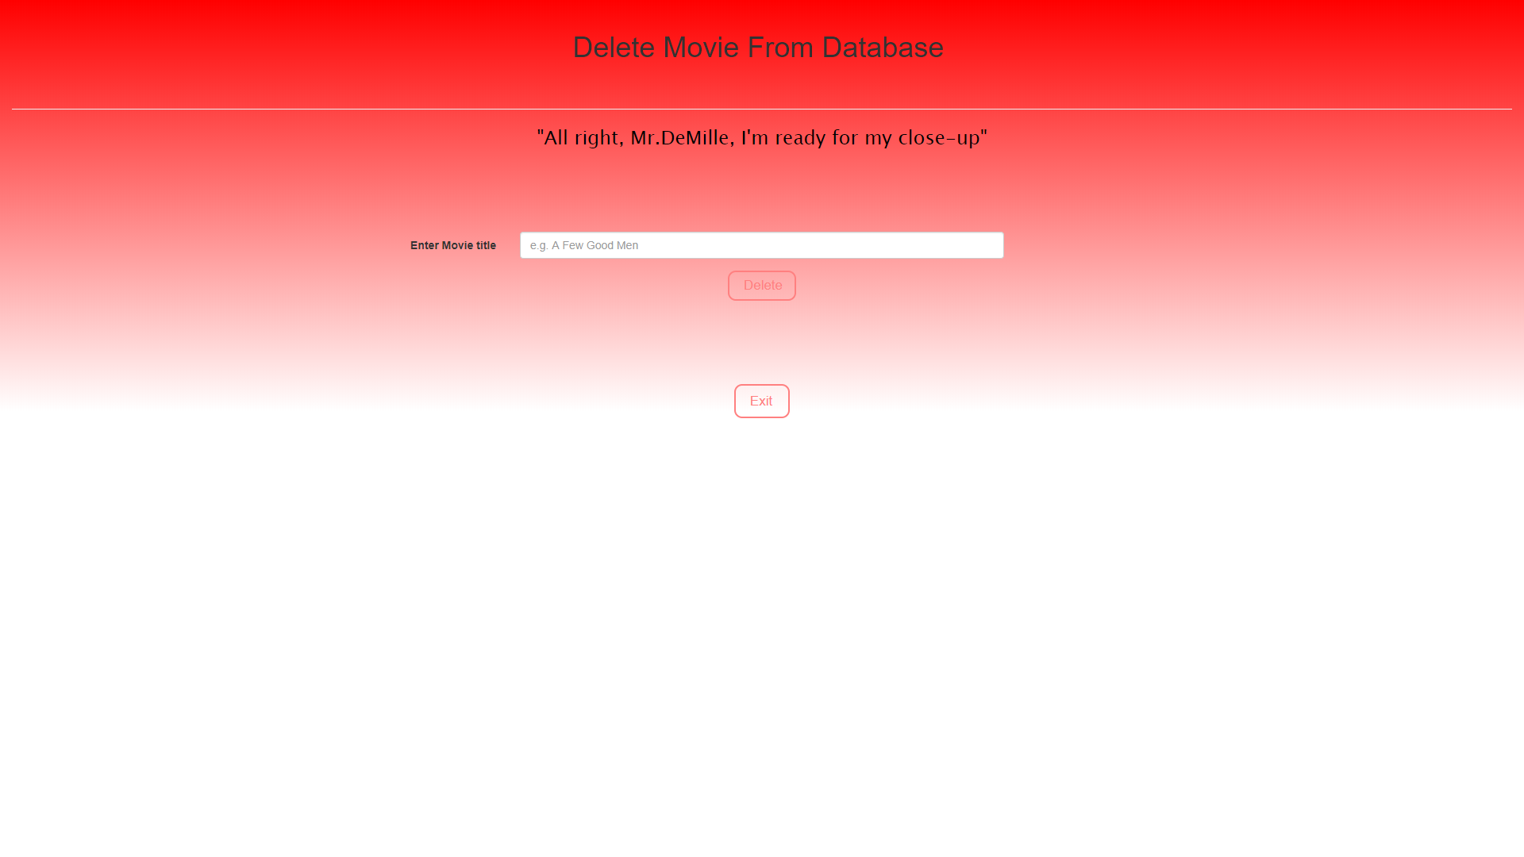

Slide 20
Live Demo

Slide 21
Subscriber Editing Account Information
Scenario 1

Slide 22
Prospective Customer Browsing the Site
Scenario 2

Slide 23
New Customer Signing Up
Scenario 3

Slide 24
Site Map

